Slide 1

Sanjivani Rural Education Society
Sanjivani College of Engineering Kopargaon – 423 601
(An Autonomous Institute, Affiliated to Savitribai Phule Pune University, Pune )
Process Scheduling Simulator
This presentation showcases a simulator replicating key CPU scheduling algorithms.
Group 10 :
Achare Tanmay (01)
Tambe Ajinkya (02)
Walke Akshata (03)
Unde Ashwini (04)
Guided by : Dr. S.N. Gunjal
Notes:
1

Slide 2
Problem Statement
CPU scheduling is a key function of modern operating systems, determining how processes are executed on the CPU.
This project presents a web-based Process Scheduling Simulator that helps users:
Visualize how different algorithms (FCFS, SJF, Round Robin, Priority) work
Input custom process data (arrival time, burst time, priority)
View Gantt charts and performance metrics like waiting time and turnaround time
It serves as an intuitive and interactive tool to learn and compare CPU scheduling techniques.
Notes:
2

Slide 3
Objectives
The primary goal of this project is to:
Simulate key CPU scheduling algorithms (FCFS, SJF, Priority, and Round Robin).
Allow users to input process parameters such as arrival time, burst time, and priority.
Generate a Gantt chart showing how processes are scheduled.
Compute and display performance metrics:
Waiting Time
Turnaround Time
CPU Utilization
Average times and throughput
Notes:
2

Slide 4
Algorithms Used
1. FCFS (First-Come, First-Served) Scheduling:-
Definition:
FCFS is the simplest CPU scheduling algorithm. The process that arrives first is executed first, regardless of its burst time.
Characteristics:
Non-preemptive
Processes are executed in the order of arrival
Queue-based scheduling
2. SJF (Shortest Job First) Scheduling:-
Definition:
SJF selects the process with the shortest CPU burst time next. It can be implemented as non-preemptive or preemptive
(also known as Shortest Remaining Time First or SRTF).
Characteristics:
Non-preemptive (SJF) or Preemptive (SRTF)
Minimizes average waiting time
Requires accurate prediction of burst time
Notes:
4

Slide 5
Algorithms Used
3. Priority Scheduling:-
Definition:
Each process is assigned a priority, and the CPU is allocated to the process with the highest priority. Ties are broken using FCFS.
Characteristics:
Can be preemptive or non-preemptive
Priorities can be static or dynamic
4. Round Robin Scheduling
Definition:
Round Robin scheduling assigns a fixed time slice (quantum) to each process in the ready queue in a cyclic order.
If a process doesn't finish within its time quantum, it’s moved to the end of the queue.
Characteristics:
Preemptive
Time-sharing system
Each process gets equal CPU time in cycles
Notes:
4

Slide 6
Technology Stack
Frontend
ReactJs, Typescript, JavaScript
Visualization
Gantt Charts, Statistical Graphs
Hosting
Vercel
Version Control
Git & GitHub
Notes:
4

Slide 7
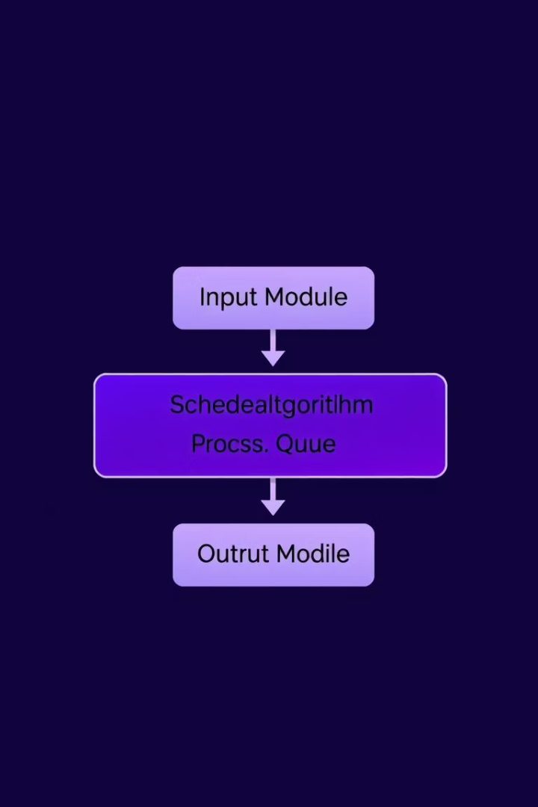
System Architecture / Workflow
1
Input Module
User enters process details
2
Scheduling Core
Selects a scheduling algorithm
3
Monitoring Module
Tracks processes states in real-time.
4
Output Renderer
Generates Gantt charts and metrics.
Notes:
5

Slide 8

Output Metrics
Example Table (use real values from a test case):
Metrics Explained:
Waiting Time = Start Time – Arrival Time
Turnaround Time = Completion Time – Arrival Time
CPU Utilization = (Total Burst Time / Total Time) × 100%
Throughput = Total Completed Processes / Total Time
Notes:
8

Slide 9
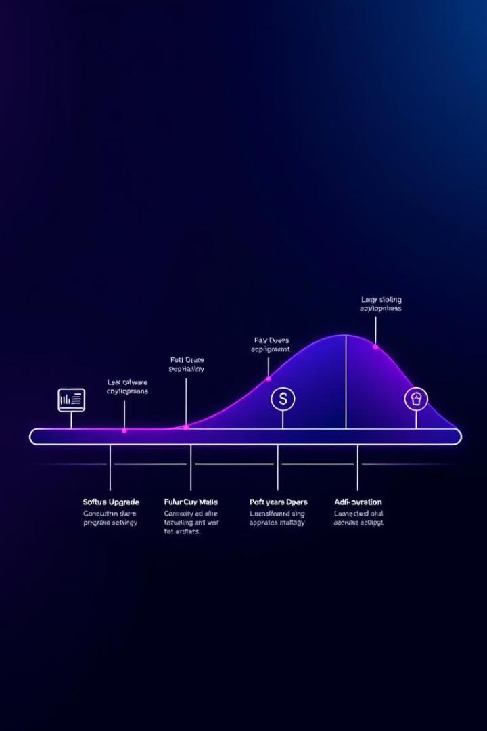
Limitations
Does not simulate real-time execution
Supports only basic scheduling algorithms
Assumes CPU-bound processes (no I/O or interrupts)
Requires manual process input (no file/data import)
Simulates single-core CPU only (no parallel execution)
Notes:
9

Slide 10


Conclusion
The project successfully simulates core scheduling algorithms.
It provides a visual and practical understanding of CPU scheduling.
Can be a helpful educational tool for OS learners.
Notes:
10

Slide 11
THANKYOU
Notes:
10

